Slide 1
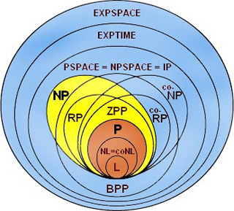
https://brilliant.org/wiki/complexity-theory/

Slide 2
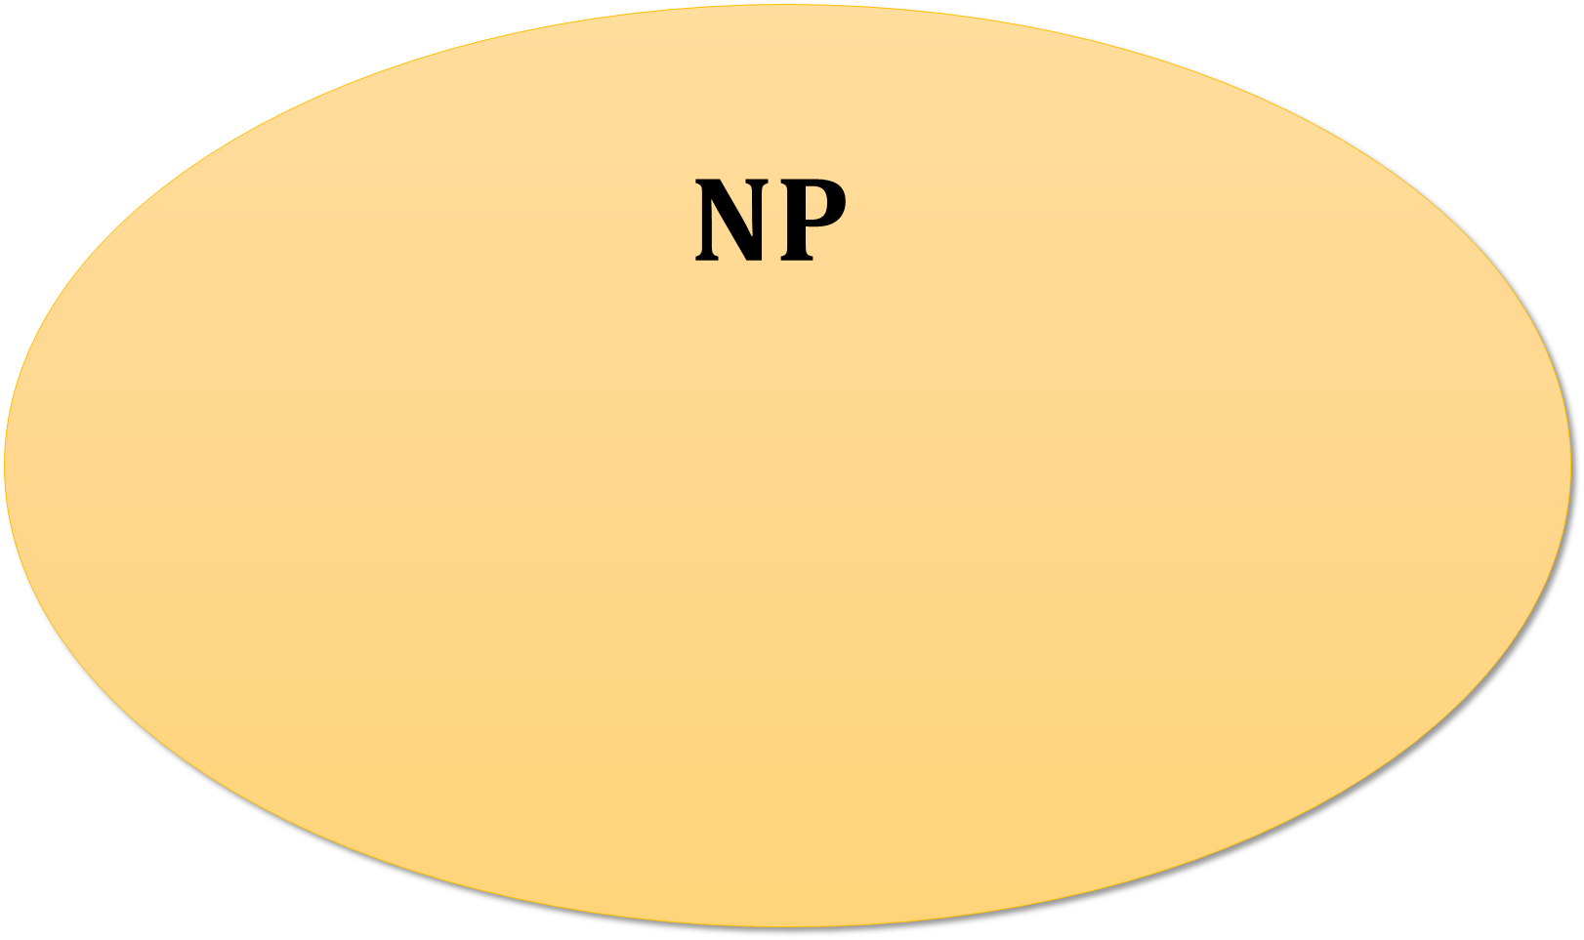
Nondeterministic Polynomial-time
$$NP$$
Sudoku
(from puzzle games)
Satisfiability
(from logic)
Hamiltonian Path
(from graph theory)
Graph Isomorphism
(from graph theory)
Linear Programming
(from optimization)
Integer Programming
(from optimization)
Integer Factoring
(from number theory)

Slide 3
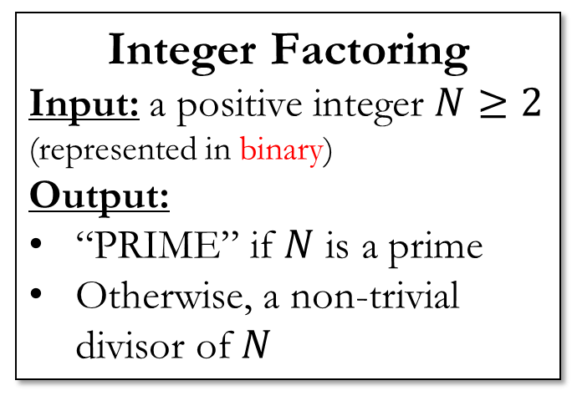
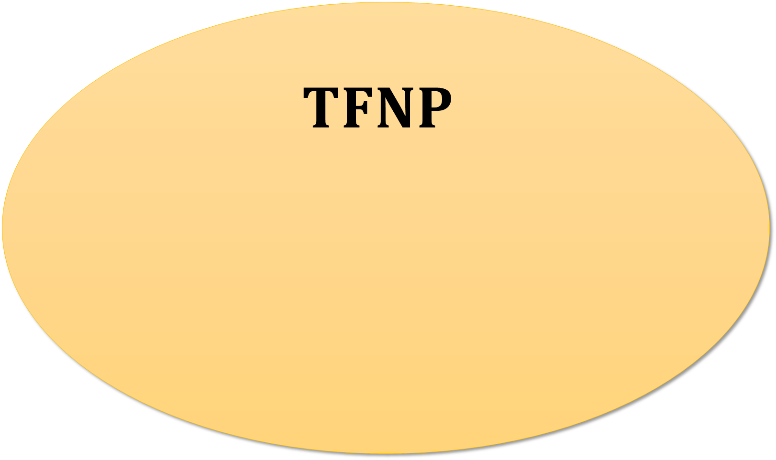
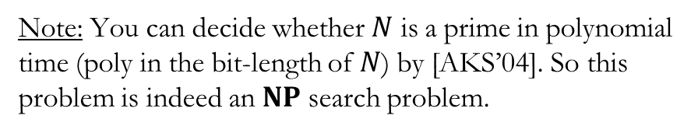
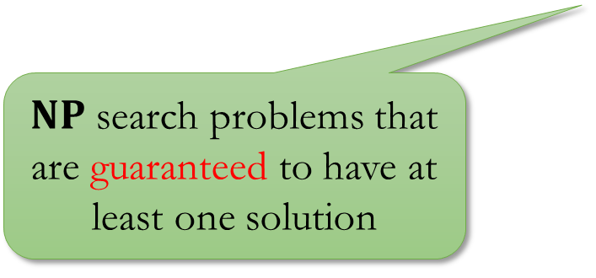
Total Functions in NP
$$TFNP$$
Personal opinion: Should really be “total search problems”, not “total functions”…
$NP$ search problems that are guaranteed to have at least one solution
Integer Factoring
Input: a positive integer $N≥2$
(represented in binary)
Output:
“PRIME” if $N$ is a prime
Otherwise, a non-trivial divisor of $N$
Note: You can decide whether $N$ is a prime in polynomial time (poly in the bit-length of $N$) by [AKS’04]. So this problem is indeed an $NP$ search problem.

Slide 4
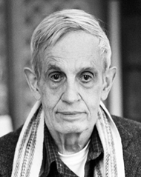
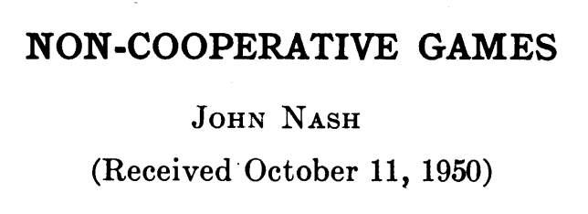
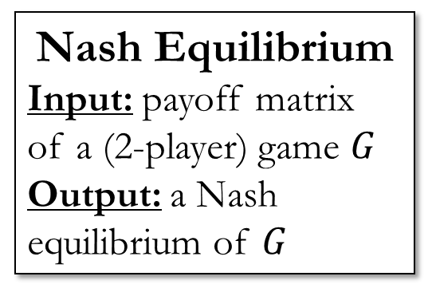
Total Functions in NP
$$TFNP$$
Nash Equilibrium
Input: payoff matrix of a (2-player) game $G$
Output: a Nash equilibrium of $G$
Integer Factoring
John Nash

Slide 5
Total Functions in NP
$$TFNP$$
Nash Equilibrium [MP’89, CDT’09]
Integer Factoring
ARRIVAL [DGKMW’17]
Locally Maximum Cut [JPY’88]
KKT Fixed Point
[FGHS’22]
Brouwer Fixed Point [MP’89]

Slide 6
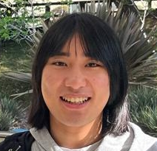





Total Search Problems in $ZPP$
Total Functions in Zero-error Probabilistic Polynomial-time
$$FNP$$
$$TFNP$$
$$TFZPP$$
$$FP$$
Hanlin Ren
(IAS)

Slide 7



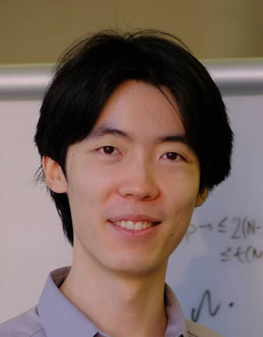


Joint work with…
Noah Fleming
(Lund)
Stefan Grosser
(McGill)
Siddhartha Jain
(UT Austin)
Jiawei Li
(UT Austin)
Morgan Shirley
(Lund)
Weiqiang Yuan
(EPFL)
Notes:
TODO

Slide 8
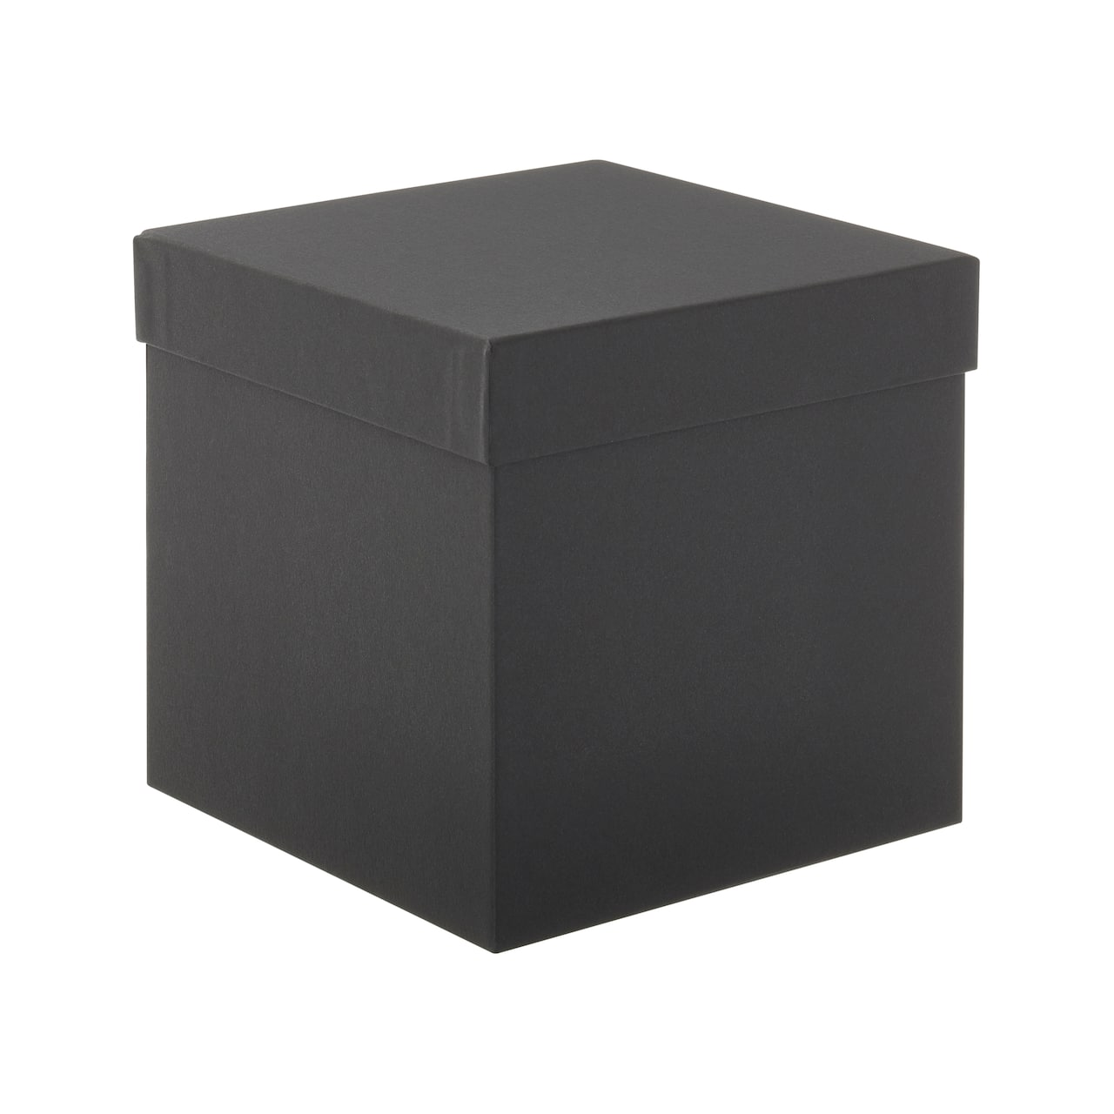
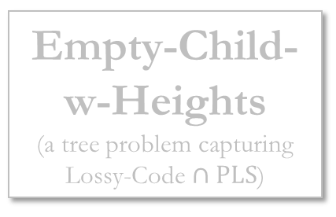
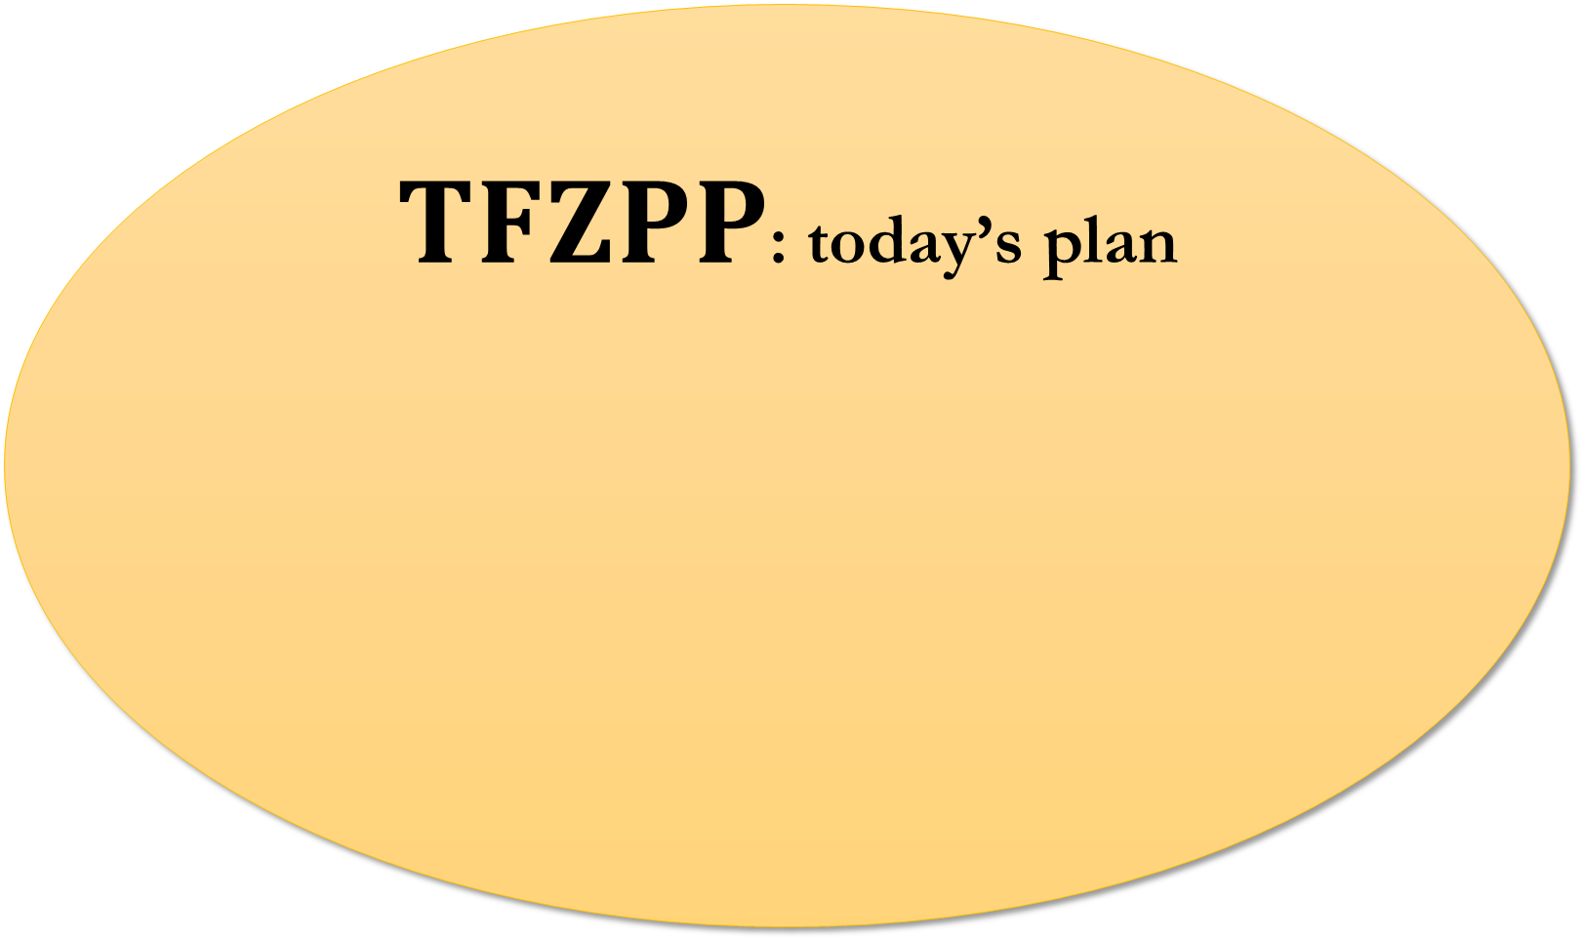
Total Functions in Zero-error Probabilistic Polynomial-time
$TFZPP$: today’s plan
Find a prime!
Nephew
Lossy-Code
Nephew
Refuting a circuit!
Bijective Lossy-Code
Empty-Child
Dense Linear Ordering
Empty-Child-w-Heights
(a tree problem capturing $\text{Lossy}\text{−}\text{Code}∩PLS$)
More to be discovered…

Slide 9
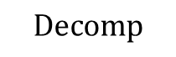

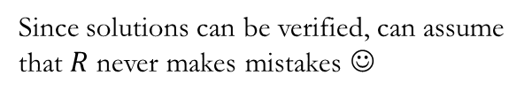
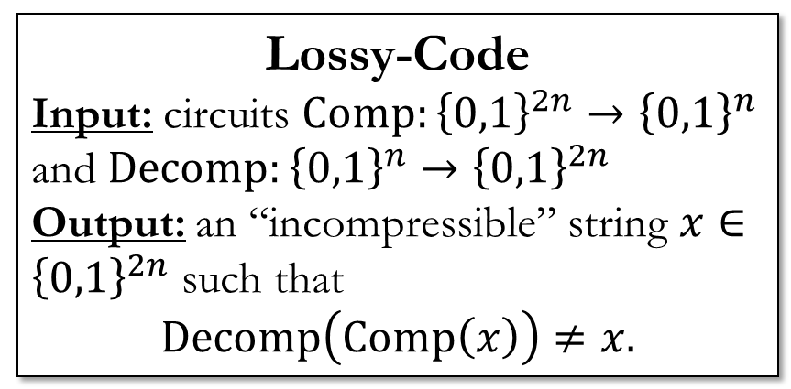

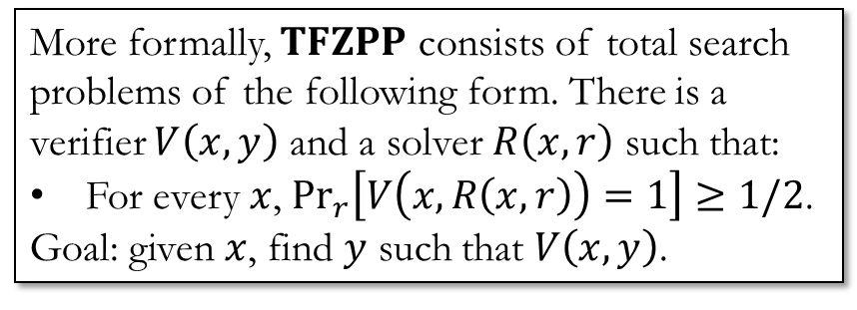

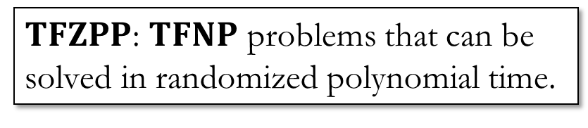
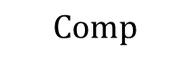
$TFZPP$: Definition
Lossy-Code
Input: circuits $Comp:{\left\{0,1\right\}}^{2n}→{\left\{0,1\right\}}^{n}$ and $Decomp:{\left\{0,1\right\}}^{n}→{\left\{0,1\right\}}^{2n}$
Output: an “incompressible” string $x∈{\left\{0,1\right\}}^{2n}$ such that
$$Decomp\left(Comp\left(x\right)\right)≠x.$$
$TFZPP$: $TFNP$ problems that can be solved in randomized polynomial time.
More formally, $TFZPP$ consists of total search problems of the following form. There is a verifier $V\left(x,y\right)$ and a solver $R\left(x, r\right)$ such that:
For every $x$, $\underset{r}{Pr}\left[V\left(x,R\left(x,r\right)\right)=1\right]≥1/2$.
Goal: given $x$, find $y$ such that $V\left(x,y\right)$.
$$??$$
$$Decomp$$
Since solutions can be verified, can assume that $R$ never makes mistakes ☺
$$Comp$$
$$x$$

Slide 10
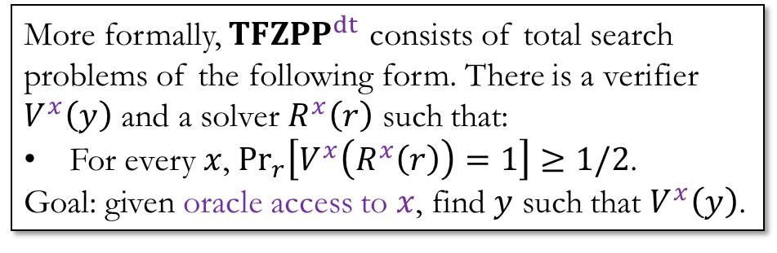

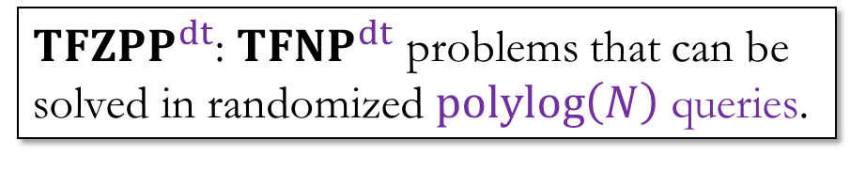
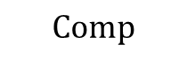
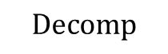
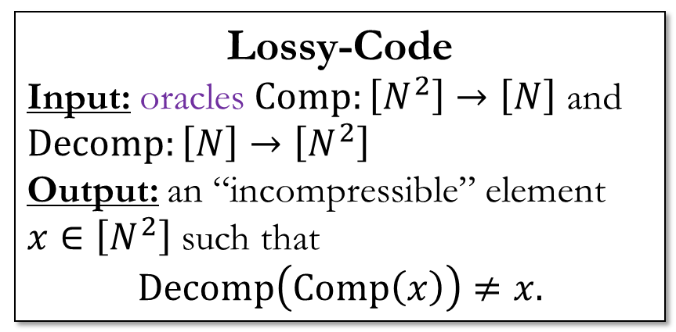
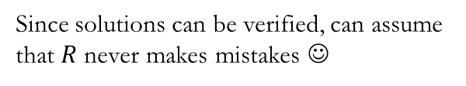
Black-box $TFZPP^{dt}$
“dt” stands for decision trees
$TFZPP^{dt}$: $TFNP^{dt}$ problems that can be solved in randomized $polylog\left(N\right)$ queries.
Lossy-Code
Input: oracles $Comp:\left[N^{2}\right]→\left[N\right]$ and $Decomp:\left[N\right]→\left[N^{2}\right]$
Output: an “incompressible” element $x∈\left[N^{2}\right]$ such that
$$Decomp\left(Comp\left(x\right)\right)≠x.$$
More formally, $TFZPP^{dt}$ consists of total search problems of the following form. There is a verifier $V^{x}\left(y\right)$ and a solver $R^{x}\left(r\right)$ such that:
For every $x$, $\underset{r}{Pr}\left[V^{x}\left(R^{x}\left(r\right)\right)=1\right]≥1/2$.
Goal: given oracle access to $x$, find $y$ such that $V^{x}\left(y\right)$.
Since solutions can be verified, can assume that $R$ never makes mistakes ☺
$$Decomp$$
$$Comp$$
https://www.michaels.com/product/black-box-by-celebrate-it-10406305

Slide 11


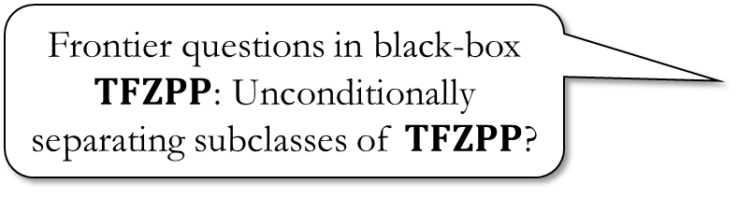
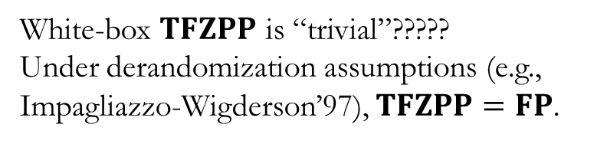
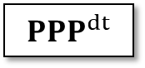
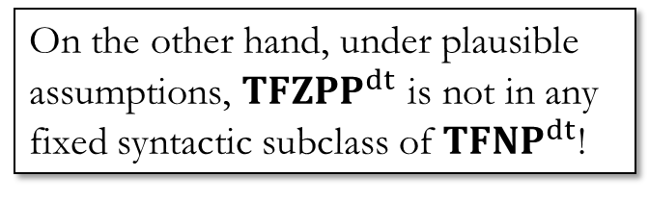


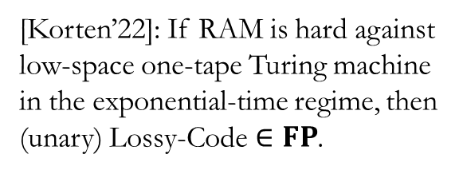
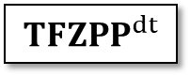
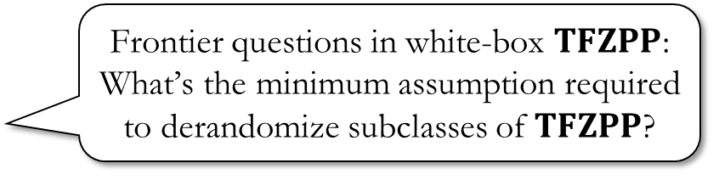

Black-box vs white-box
On the other hand, under plausible assumptions, ${TFZPP}^{dt}$ is not in any fixed syntactic subclass of ${TFNP}^{dt}$!
White-box $TFZPP$ is “trivial”?????
Under derandomization assumptions (e.g., Impagliazzo-Wigderson’97), $TFZPP=FP$.
$${TFNP}^{dt}$$
Frontier questions in white-box $TFZPP$: What’s the minimum assumption required to derandomize subclasses of $TFZPP$?
$${PLS}^{dt}$$
$${PPP}^{dt}$$
$${YFTC}^{dt}$$
Your Favorite $TFNP$ Class
$${TFZPP}^{dt}$$
[Korten’22]: If RAM is hard against low-space one-tape Turing machine in the exponential-time regime, then (unary) $\text{Lossy}\text{−}\text{Code}∈FP$.
Frontier questions in black-box $TFZPP$: Unconditionally separating subclasses of $TFZPP$?

Slide 12

TFZPP gallery
https://thenounproject.com/icon/photo-gallery-17840/

Slide 13

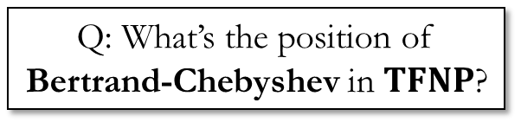
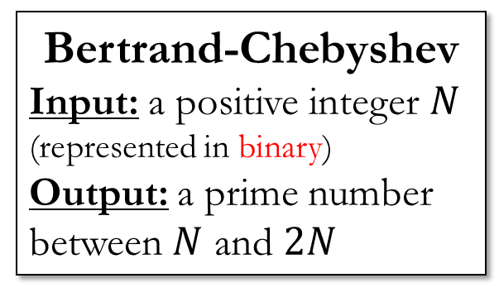
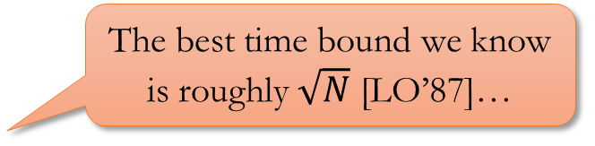
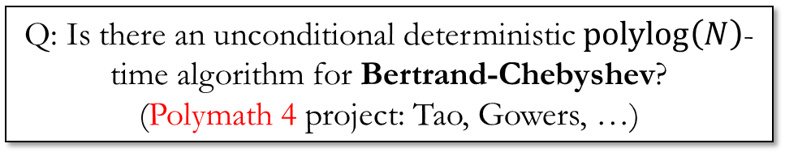
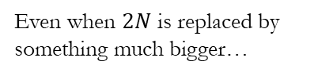
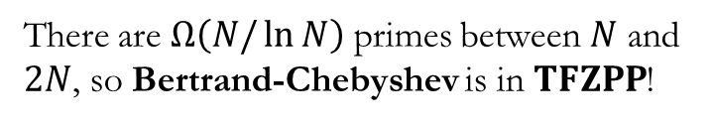
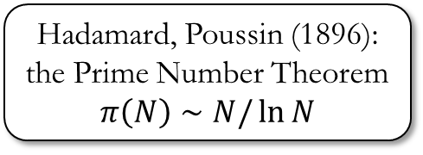
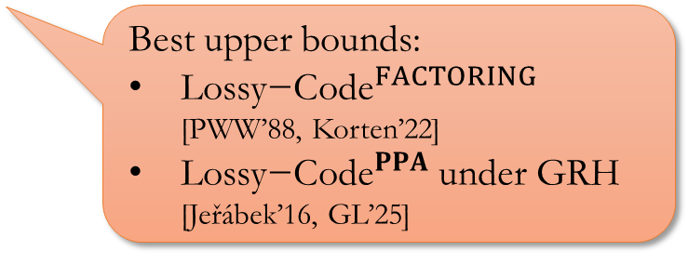
Finding a prime
Joseph Bertrand (1845): Conjectured that such a prime always exists
Q: Is there an unconditional deterministic $polylog\left(N\right)$-time algorithm for Bertrand-Chebyshev? (Polymath 4 project: Tao, Gowers, …)
Pafnuty Chebyshev (1852): Proved Bertrand’s conjecture
Bertrand-Chebyshev
Input: a positive integer $N$ (represented in binary)
Output: a prime number between $N$ and $2N$
The best time bound we know is roughly $\sqrt{N}$ [LO’87]…
Q: What’s the position of Bertrand-Chebyshev in $TFNP$?
Best upper bounds:
${\text{Lossy}\text{−}\text{Code}}^{FACTORING}$ [PWW’88, Korten’22]
${\text{Lossy}\text{−}\text{Code}}^{PPA}$ under GRH [Jeřábek’16, GL’25]
Hadamard, Poussin (1896): the Prime Number Theorem
$$π\left(N\right)∼N/\ln{N}$$
There are $Ω\left(N/\ln{N}\right)$ primes between $N$ and $2N$, so Bertrand-Chebyshev is in $TFZPP$!
Even when $2N$ is replaced by something much bigger…

Slide 14
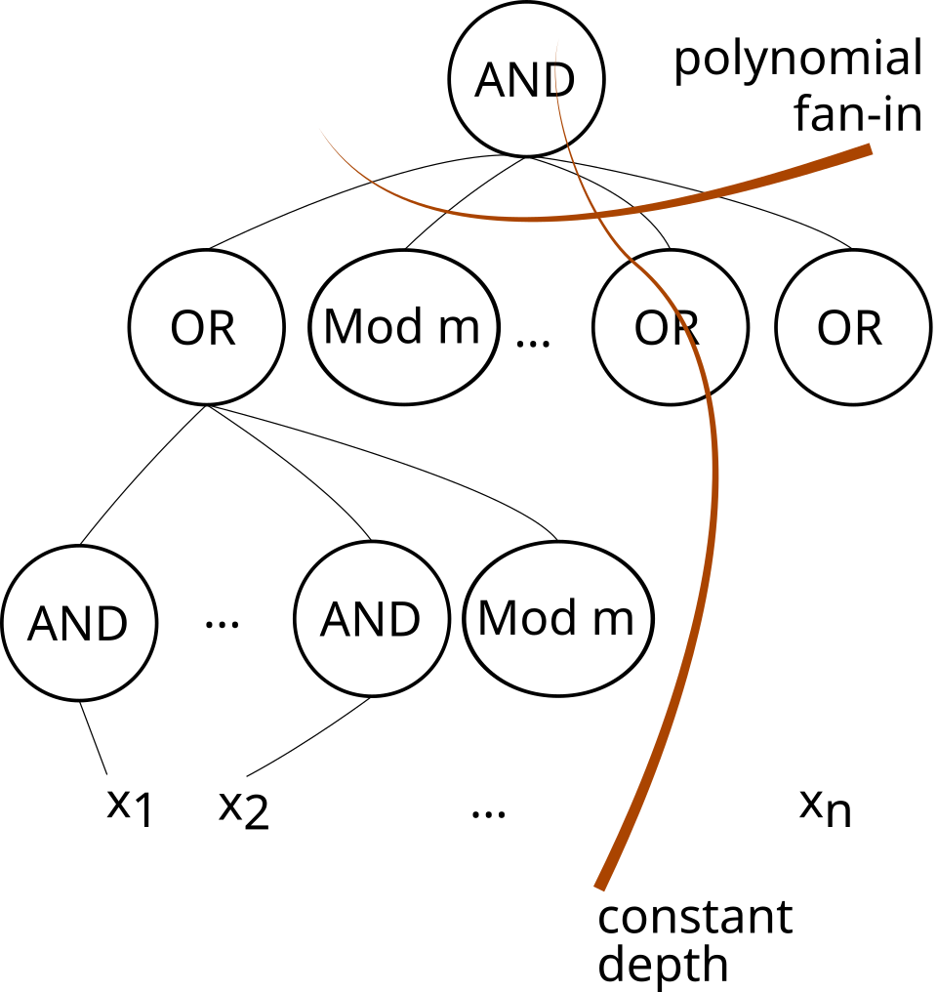
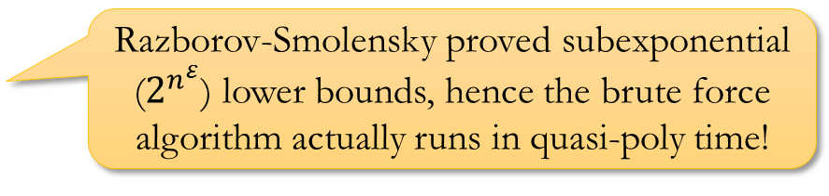
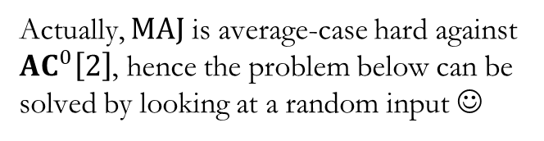
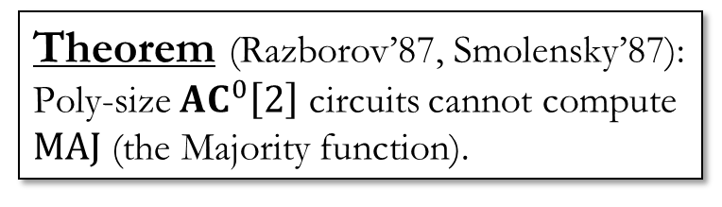
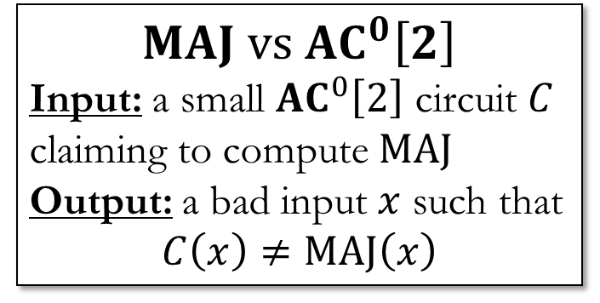
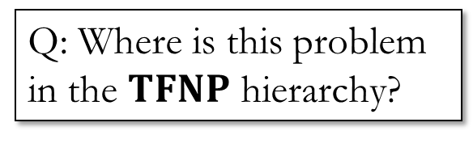
Refuting a circuit
Q: Can we solve this problem in deterministic polynomial time?
Theorem (Razborov’87, Smolensky’87):
Poly-size ${AC}^{0}\left[2\right]$ circuits cannot compute $MAJ$ (the Majority function).
“Constructivize” / “witness” your lower bounds! (CJSW’21, CTW’23, PS’23)
Actually, $MAJ$ is average-case hard against ${AC}^{0}\left[2\right]$, hence the problem below can be solved by looking at a random input ☺
Razborov-Smolensky proved subexponential ($2^{n^{ε}}$) lower bounds, hence the brute force algorithm actually runs in quasi-poly time!
$$MAJ vs {AC}^{0}\left[2\right]$$
Input: a small ${AC}^{0}\left[2\right]$ circuit $C$ claiming to compute $MAJ$
Output: a bad input $x$ such that
$$C\left(x\right)≠MAJ\left(x\right)$$
Q: Where is this problem in the $TFNP$ hierarchy?
Nothing is known. ☹
https://en.wikipedia.org/wiki/ACC0#/media/File:Diagram_of_an_ACC0_Circuit.svg

Slide 15

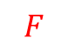
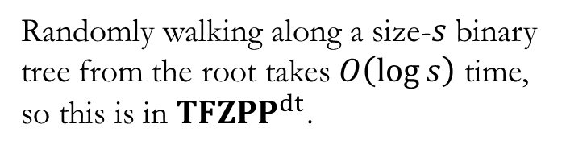

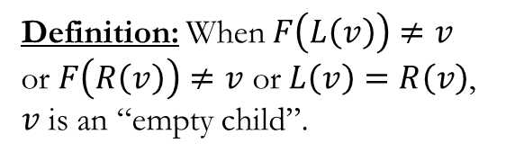




Walking along a binary tree
Empty-Child
Input: a rooted binary tree described by three functions $F$ (parent), $L$ (left child), $R$ (right child)
Output: a leaf of the tree
$$F$$
$⋆$
$$L$$
$$R$$
Randomly walking along a size-$s$ binary tree from the root takes $O\left(\log{s}\right)$ time, so this is in ${TFZPP}^{dt}$.
$$v$$
Definition: When $F\left(L\left(v\right)\right)≠v$ or $F\left(R\left(v\right)\right)≠v$ or $L\left(v\right)=R\left(v\right)$, $v$ is an “empty child”.
$$?$$
This paper: Empty-Child is equivalent to Lossy-Code ☺

Slide 16












Dense Linear Ordering
Dense Linear Ordering
Input:
A comparator $CMP\left(x,y\right)∈\left\{\text{True},\text{False}\right\}$
A “median” function $MED\left(x,y\right)∈\left[N\right]$
Output:
Violation of transitivity: $x,y,z$ such that $CMP\left(x,y\right)$, $CMP\left(y,z\right)$, and $CMP\left(z,x\right)$.
Violation of median: $x,y$ such that $CMP\left(x,y\right)$ but, for $z=MED(x,y)$, it is not the case that $\left(CMP\left(x,z\right) \text{and} CMP\left(z,y\right)\right)$.
Exercise: DLO is in $TFZPP$.
Exercise 2: In fact, DLO reduces to Lossy-Code.
If there are $N$ elements, can represent in $\left({N \atop 2}\right)$ bits!
$$=MED\left( , \right)$$
$$=MED\left( , \right)$$
$$=MED\left( , \right)$$
$$=MED\left( , \right)$$
$$=MED\left( , \right)$$
$$=MED\left( , \right)$$
$$=MED\left( , \right)$$
$CMP\left(x,x\right)$ is always $\text{False}$
$$MED\left( , \right)=??$$

Slide 17


Slide 18
Nephew

Slide 19












Nephew
Input: Functions $f:\left[N\right]→\left[N\right]$ (“parent”) and $g:\left[N\right]→\left[N\right]$ (“nephew”)
Output: $v∈\left[N\right]$ such that
$$f\left(g\left(v\right)\right)=v \text{or} f\left(f\left(g\left(v\right)\right)\right)≠f\left(v\right).$$
$$f$$
$$g$$
$$fgv$$
$$ffgv$$
$$v$$
$$v$$
$$fgv$$
$$gv$$
$$gv$$
“$fgv=v$”
❌
“$ffgv=fv$”
✔️

Slide 20




Nephew
Input: Functions $f:\left[N\right]→\left[N\right]$ (“parent”) and $g:\left[N\right]→\left[N\right]$ (“nephew”)
Output: $v∈\left[N\right]$ such that
$$f\left(g\left(v\right)\right)=v \text{or} f\left(f\left(g\left(v\right)\right)\right)≠f\left(v\right).$$
$$f$$
$$g$$
$$?$$

Slide 21
Nephew
Input: Functions $f:\left[N\right]→\left[N\right]$ (“parent”) and $g:\left[N\right]→\left[N\right]$ (“nephew”)
Output: $v∈\left[N\right]$ such that
$$f\left(g\left(v\right)\right)=v \text{or} f\left(f\left(g\left(v\right)\right)\right)≠f\left(v\right).$$
$$f$$
$$g$$

Slide 22








Credit: BGG’01
Page 310, Proposition 6.5.5
$$∀x∃y \left(ffy=fx \text{and} fy≠x\right)$$
$$∀x\left(ffgx=fx \text{and} fgx≠x\right)$$
$$x$$
$$x$$
Where’s my $y$?
$$…$$
$$y$$
https://www.amazon.com/Classical-Decision-Problem-Egon-B%C3%B6rger/dp/3540423249

Slide 23









Nephew $∈TFZPP$
$$f$$
Level $0$
Level $1$
$$v^{∗}$$
Level $2$
Level $3$
Level $4$
Step I: Find a vertex $v^{∗}$ at level $≥2$ (randomly)
Step II: Randomly walk down some binary tree!

Slide 24












Nephew $∈TFZPP$
$$f$$
Definition:
$$h(x)≔g\left(f\left(g\left(x\right)\right)\right)$$
$$v^{∗}$$
Level $ℓ\left(v^{∗}\right)$
$$g$$
$$h$$
Level $ℓ\left(v^{∗}\right)+1$
$$x$$
Level $ℓ\left(v^{∗}\right)+2$
$$hx$$
Level $ℓ\left(v^{∗}\right)+3$
Step I: Find a vertex $v^{∗}$ at level $≥2$ (randomly)
Step II: Randomly walk down some binary tree!
DAG?!

Slide 25
























Assumption
For every vertex $v$ we “encounter”,
$$fgv≠v \text{and} ffgv=ffhv=fv.$$
$$f$$
Definition:
$$h(x)≔g\left(f\left(g\left(x\right)\right)\right)$$
$$g$$
Base case: only one vertex at level $ℓ\left(v^{∗}\right)$.
$$h$$
Lemma: The nodes in the sub-DAG of $v^{∗}$ have different $f$ values.
$$v^{∗}$$
Level $ℓ\left(v^{∗}\right)$
Teaser case (level $ℓ\left(v^{∗}\right)+1$):
$$fu=fgv^{∗} \text{and} fw=fgfgv^{∗}$$
$$fg\left(fgv^{∗}\right)≠fgv^{∗}$$
$$u=gv^{∗}$$
$$w=hv^{∗}$$
Level $ℓ\left(v^{∗}\right)+1$
Level $ℓ\left(v^{∗}\right)+2$
Full case:
If $fgw_{1}=fhw_{2}$, then
$$ffgw_{1}=ffhw_{2}$$
$$fw_{1}=fw_{2}$$
$w_{1}=w_{2}$ (by IH)
Level $ℓ\left(v^{∗}\right)+3$
Full case:
If $fgw_{1}=fgw_{2}$, then
$$ffgw_{1}=ffgw_{2}$$
$$fw_{1}=fw_{2}$$
$w_{1}=w_{2}$ (by IH)
$$w_{1}$$
$$w_{2}$$
$$w$$
$$gw$$
$$hw$$
$$gw_{1}$$
$$gw_{2}$$

Slide 26







Assumption
For every vertex $v$ we “encounter”,
$$fgv≠v \text{and} ffgv=ffhv=fv.$$
Assumption
For every vertex $v$ we “encounter”,
$$fgv≠v \text{and} ffgv=fv.$$
$$f$$
Definition:
$$h(x)≔g\left(f\left(g\left(x\right)\right)\right)$$
$$g$$
$$h$$
Lemma: The nodes in the sub-DAG of $v^{∗}$ have different $f$ values.
$$v^{∗}$$
Level $ℓ\left(v^{∗}\right)$
Theorem: Different vertices in the sub-DAG of $v^{∗}$ have different $g$ and $h$ values.
(That is, the sub-DAG is a subtree.)
$$u=gv^{∗}$$
$$w=hv^{∗}$$
Level $ℓ\left(v^{∗}\right)+1$
Level $ℓ\left(v^{∗}\right)+2$
Level $ℓ\left(v^{∗}\right)+3$
If $gu_{1}=gu_{2}$, then
$$ffgu_{1}=ffgu_{2}$$
$$fu_{1}=fu_{2}$$
If $gu_{1}=hu_{2}$, then
$$ffgu_{1}=ffhu_{2}$$
$$fu_{1}=fu_{2}$$
$$u_{1}$$
$$u_{2}$$

Slide 27







Assumption
For every vertex $v$ we “encounter”,
$$fgv≠v \text{and} ffgv=ffhv=fv.$$
$$f$$
Final Step
How to choose $v^{∗}$ such that $ℓ\left(v^{∗}\right)≥2$?
$$g$$
$$u$$
Level $0$
Level $1$
Choose some vertex $u$ arbitrarily.
Case I: Perhaps $u$ is already at level $≥2$?
Case II: If $u$ is at level $0$, then $g(u)$ is at level $2$.
Case III: If $u$ is at level $1$ then $f(u)$ is at level $0$, hence $g(f\left(u\right))$ is at level $2$.
Level $2$
$1/3$ success probability by choosing $\left\{u,g\left(u\right),g\left(f\left(u\right)\right)\right\}$ randomly ☺

Slide 28






Wrap up
Nephew
Input: Functions $f:\left[N\right]→\left[N\right]$ (“parent”) and $g:\left[N\right]→\left[N\right]$ (“nephew”)
Output: $v∈\left[N\right]$ such that
$$f\left(g\left(v\right)\right)=v \text{or} f\left(f\left(g\left(v\right)\right)\right)≠f\left(v\right).$$
Nephew $∈TFZPP$
Create a binary tree from $g$ and $h$, where
$$h\left(x\right)≔g\left(f\left(g\left(x\right)\right)\right)$$
1*. Prove that this is, indeed, a binary tree!
Randomly choose $v^{∗}$ on level $≥2$
Randomly walk down the binary tree from $v^{∗}$
$$f$$
$$g$$
A similar argument shows that $Nephew∈PWPP$ (Poly-time weak pigeonhole principle)
Open problem: Can you reduce Nephew to Lossy-Code in the black-box setting?
$$?$$

Slide 29



Bertrand-Chebyshev
Input: a positive integer $N$ (represented in binary)
Output: a prime number between $N$ and $2N$
?
?
$$MAJ vs {AC}^{0}\left[2\right]$$
Input: a small ${AC}^{0}\left[2\right]$ circuit $C$ claiming to compute $MAJ$
Output: a bad input $x$ such that
$$C\left(x\right)≠MAJ\left(x\right)$$
?
?
Thank you!
Questions are welcome!
Figure 1 [our paper]: The $TFZPP$ zoo.

